Slide 1
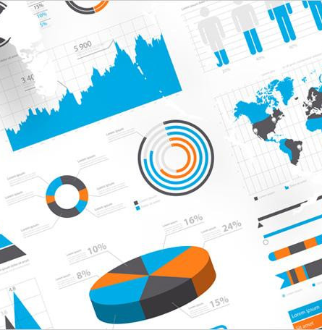
Data Visualization Tools
Ryan Nguyen

Slide 2
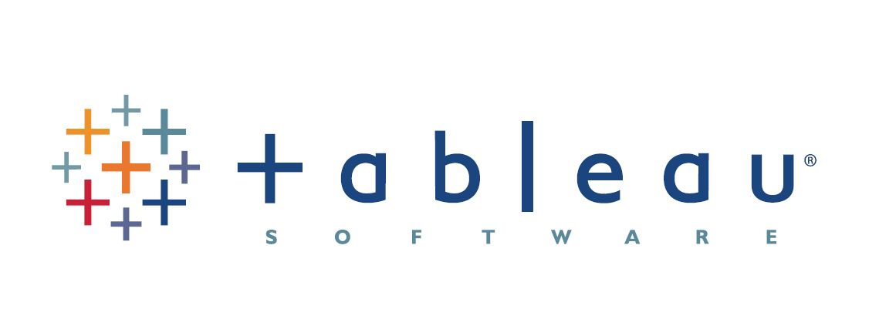
Tableau
Introduction
Considered one of the gold standards in data visualization.
Designed for many who don’t have skills.
Simplifies raw data into easily understandable format.
Great for commercial and non-commercial organizations.

Slide 3
Tableau
Features & Comparisons
Creation of interactive dashboards
Connects to various amounts of data files such as (CSV, JSON, XML, MS Excel, etc.)
Unique and intuitive interface
Wide selection of dashboards and charts.

Slide 4
Tableau
Contrasts From Competitors
Gentle learning curve for all users.
Leader in various training methods (videos, blogs, forums, social network engagement).
Flexible dashboards (overlaps) that can be used in restricted screen space area.
$70 for small business

Slide 5
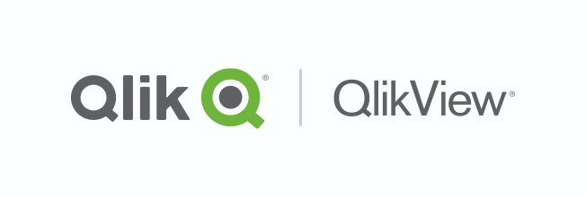
QlikView
Introduction
Easy to navigate for ordinary users.
A solution that focuses on the user as the receiver of data
Offers guided exploration, discovery, and collaborative analytics for sharing insights.
Strives to maintain the association between data.

Slide 6
QlikView
Features & Comparisons
Ability to manipulate data associations automatically.
Extremely useful for creating advanced dashboards based on data from multiple sources.
Incredibly flexible, allows to tweak every little aspect and customize the look and feel of any visualizations and dashboards.

Slide 7
QlikView
Contrasts From Competitors
Many Advance search capabilities.
Fine-tuned data visualization speed.
Can combined many different dataset of all sizes effortlessly.
$30 for Small Business

Slide 8
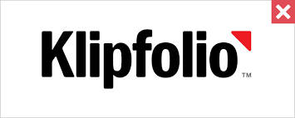
Klipfolio
Introduction
Solution that resides 100% in the cloud (no desktop application is required) providing a genuinely insightful tool for data visualization and dashboard composition.

Slide 9
Klipfolio
Features & Comparisons
Comes with some of the best features for a standard dashboard.
Easy to connect to a huge list of data sources by making use of its pre-defined connectors along with traditional way of Excel, CSV, etc.
User-friendly place to consume data. The dashboard can be shared through emails or it can be downloaded as image or pdf.

Slide 10
Klipfolio
Contrasts
Best used for live monitoring and control over continuous data flows when their dynamics are of great importance and may require urgent decisions.
Multiplatform friendly
$50 for small teams

